Slide 1


Mastering Regular Expressions: A Comprehensive Guide
Welcome to the world of Regular Expressions (Regex), a powerful tool for pattern matching and text manipulation. This comprehensive guide will take you from the basics to advanced concepts, empowering you to harness the full potential of regex in your programming journey.
Whether you're a beginner looking to understand the fundamentals or an intermediate programmer aiming to refine your skills, this presentation will provide you with the knowledge and practical examples you need to become proficient in regex.
by Dr. Tri Basuki Kurniawan

Slide 2


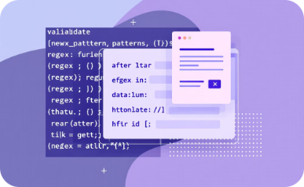

What are Regular Expressions?
Pattern Matching
Text Manipulation
Data Validation
Language Agnostic
Regex allows you to search for specific patterns within text, making it easy to find and extract information.
With regex, you can replace, split, or modify text based on complex patterns, streamlining text processing tasks.
Regex is excellent for validating input formats, such as email addresses, phone numbers, or dates.
While syntax may vary slightly, regex concepts are universal across most programming languages.

Slide 3



Real-World Use Cases for Regex
Regular expressions find applications in various domains, making them an indispensable tool for developers, data analysts, and even non-technical professionals working with text data.
Web Development
Data Analysis
System Administration
Regex is crucial for form validation, URL parsing, and content filtering in web applications. It helps ensure data integrity and enhance user experience.
When working with large datasets, regex can extract specific information patterns, clean data, or transform text into a desired format efficiently.
Regex is invaluable for log file analysis, configuration management, and automating tasks that involve text processing in system administration.

Slide 4

Getting Started with Regex
Before diving into complex patterns, it's essential to understand the building blocks of regular expressions.
Let's start with the basics that form the foundation of regex syntax.
1
Learn the Syntax
Familiarize yourself with basic regex symbols and their meanings. Understanding metacharacters like . (dot),
* (asterisk), and + (plus) is crucial.
2
Practice Simple Patterns
Start with simple patterns like matching specific words or numbers. This helps build confidence and
understanding of how regex works.
3
Use Online Tools
Utilize regex testers and visualizers available online to experiment with patterns and see real-time results.
4
Apply to Real Text
Once comfortable, start applying regex to actual text data, gradually increasing complexity as you gain
proficiency.

Slide 5

Character Classes and Sets
Character classes and sets are fundamental components of regex that allow you to match specific types of characters or a range of characters. They provide flexibility in pattern matching and are essential for creating precise regex patterns.
[abc]
[^abc]
Matches any single character in the set. For example, [aeiou] matches any vowel.
Matches any single character not in the set. [^0-9] matches any non-digit character.
[a-z]
\d, \w, \s
Matches any single character in the range. [A-Z] matches any uppercase letter.
Predefined classes for digits, word characters, and whitespace respectively.

Slide 6

Quantifiers in Regex
Quantifiers in regular expressions specify how many instances of a character, group, or character class must be present in the input for a match to be found. They are powerful tools that allow you to control the repetition of patterns.
*
Matches 0 or more occurrences
+
Matches 1 or more occurrences
?
Matches 0 or 1 occurrence
{n}
Matches exactly n occurrences
{n,}
Matches n or more occurrences
{n,m}
Matches between n and m occurrences
Understanding and effectively using quantifiers is crucial for creating flexible and precise regex patterns. They allow you to handle variations in text length and repetition, making your patterns more robust and versatile.

Slide 7

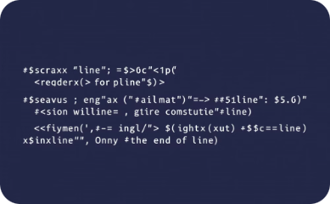
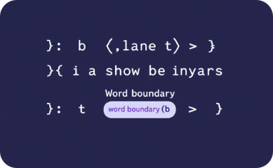
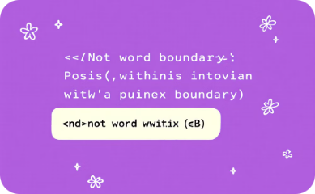
Anchors and Boundaries
\B (Not Word Boundary)
^ (Caret)
$ (Dollar)
\b (Word Boundary)
Matches the start of a line. For example, ^Hello matches "Hello" only at the beginning of a line.
Matches the end of a line. World$ matches "World" only at the end of a line.
Matches a position where a word character is not followed or preceded by another word character.
Matches any position that is not a word boundary.
Using anchors and boundaries effectively can significantly improve the precision of your regex patterns, ensuring that matches occur exactly where you expect them to.

Slide 8

Special Characters and Escaping
Regular expressions use various special characters to define patterns. However, sometimes you need to match these special characters literally. This is where escaping comes into play.
1
Metacharacters
2
Escaping
Characters like ., *, +, ?, ^, $, (, ), [, ], {, }, |, and \ have special meanings in regex.
To match these characters literally, you need to escape them with a backslash (\). For example, \. matches a literal period.
3
Backslash Sequences
4
Raw Strings
Some escaped characters have special meanings, like \d for digits or \s for whitespace.
In many programming languages, using raw strings (r"pattern") can simplify regex by treating backslashes literally.
Understanding how to properly escape special characters is crucial for creating accurate regex patterns, especially when dealing with text that contains punctuation or special symbols.

Slide 9





Groups and Capturing
Groups in regular expressions allow you to treat multiple characters as a single unit. They are created by enclosing characters in parentheses. Capturing groups not only group characters but also create a capture - a saved sub-pattern that can be reused.
Define Group
Apply Quantifiers
Use parentheses to create a group. For example, (abc) groups the characters 'abc' together.
Quantifiers can be applied to groups. (abc)+ matches one or more occurrences of 'abc'.
Capture
Backreference
By default, groups capture their match, allowing you to reference it later in the regex or in replacement patterns.
Use \1, \2, etc., to refer back to captured groups within the regex pattern.
Groups and capturing are powerful features that enable complex pattern matching and text manipulation, essential for advanced regex usage.

Slide 10
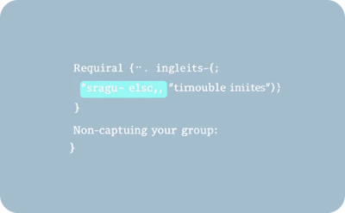
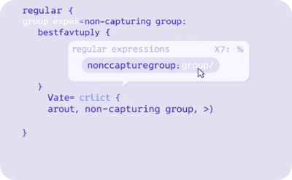
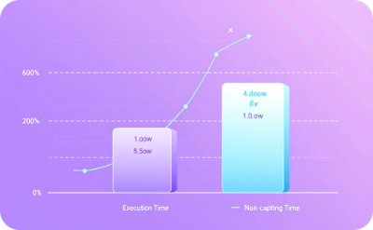
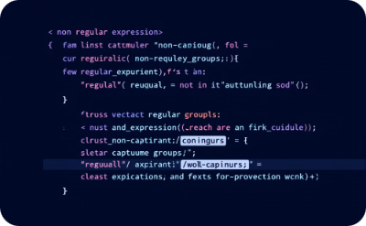
Non-Capturing Groups
Grouping Without Capturing
Readability and Organization
Syntax
Performance Boost
While capturing groups are useful, sometimes you need to group characters without creating a capture. Non-capturing groups provide this grouping functionality without the memory overhead of capturing.
Non-capturing groups are denoted by (?:pattern). The ?: at the beginning of the group indicates that it should not be captured.
Non-capturing groups can improve performance in complex regex patterns, especially when dealing with large amounts of text.
Non-capturing groups can make regex more readable by clearly indicating which parts of the pattern are just for grouping and which are for capturing.

Slide 11



Lookahead and Lookbehind Assertions
Lookahead and look behind assertions are advanced regex features that allow you to match a pattern only if it's followed by or preceded by another pattern, without including the latter in the match result.
Positive Lookahead (?=...)
Negative Lookahead (?!...)
Positive Lookbehind (?<=...)
Asserts that what follows the current position matches the pattern. For example, \d+(?=USD) matches numbers only if followed by "USD".
Asserts that what follows doesn't match the pattern. \d+(?!USD) matches numbers not followed by "USD".
Asserts that what precedes matches the pattern. (?<=\$)\d+ matches numbers preceded by a dollar sign.
These assertions provide powerful tools for creating complex matching conditions without altering the overall match, crucial for precise text analysis and manipulation.

Slide 12





Regex Flags and Modifiers
Regex flags, also known as modifiers, are used to change how a regular expression behaves. They can make your patterns more flexible and powerful by altering the way the regex engine interprets them.
i (Case Insensitive)
Makes the pattern case-insensitive. /pattern/i matches "Pattern", "PATTERN", etc.
g (Global)
Finds all matches rather than stopping after the first match.
m (Multiline)
Changes ^ and $ to match the start/end of each line instead of the whole string.
s (Dotall)
Makes the dot (.) match newline characters as well.
Understanding and using these flags can significantly enhance your regex patterns, making them more versatile and applicable to a wider range of scenarios.

Slide 13

Regex in Python: Getting Started
Python provides robust support for regular expressions through its 're' module. This built-in module offers a wide range of functions and methods to work with regex, making it a powerful tool for text processing in Python.
1
Import the Module
Start by importing the 're' module: import re
2
Create a Pattern
Define your regex pattern as a string: pattern = r'\d+'
3
Compile (Optional)
For efficiency, compile the pattern: regex = re.compile(pattern)
4
Use Regex Functions
Utilize functions like re.search(), re.match(), re.findall() to work
with your pattern
Python's regex implementation is powerful and flexible, allowing you to easily integrate regex into your Python projects for various text-processing tasks.

Slide 14

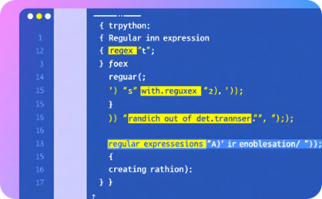
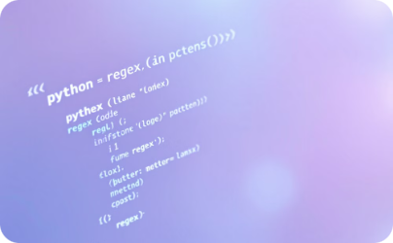
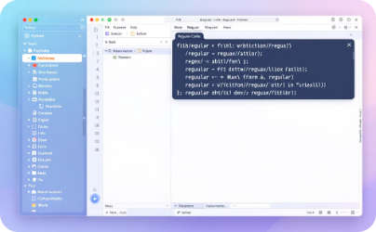
Practical Regex Examples in Python
Let's explore some practical examples of using regex in Python to solve real-world problems. These examples will demonstrate the power and versatility of regex in text-processing tasks.
Email Validation
URL Extraction
Date Formatting
Password Strength Check
pattern = r'^[\w\.-]+@[\w\.-]+\.\w+$' is_valid = re.match(pattern, email)
pattern = r'https?://\S+' urls = re.findall(pattern, text)
pattern = r'(\d{2})/(\d{2})/(\d{4})' formatted = re.sub(pattern, r'\3-\1-\2', date)
pattern = r'^(?=.*[A-Z])(?=.*[a-z])(?=.*\d)[A-Za-z\d]{8,}$' is_strong = re.match(pattern, password)
These examples showcase how regex can be used to validate input, extract information, reformat text, and enforce complex rules, all with concise and efficient code.

Slide 15

Best Practices and Performance Considerations
As you become more proficient with regex, it's important to consider best practices and performance implications to write efficient and maintainable patterns.
1
Keep It Simple
Start with the simplest pattern that solves your problem. Overly complex regex can be hard to maintain and debug.
2
Use Non-Capturing Groups
When you don't need to capture a group, use (?:...) to improve performance, especially in large texts.
3
Avoid Catastrophic Backtracking
Be cautious with nested quantifiers that can lead to exponential time complexity. Use possessive quantifiers or atomic groups when necessary.
4
Test Thoroughly
Always test your regex with various inputs, including edge cases, to ensure it behaves as expected in all scenarios.
By following these best practices, you can create regex patterns that are not only effective but also efficient and maintainable, enhancing your overall text-processing capabilities.

